Slide 1
HowToUsing ADS
Install
  실행 파일 copy
Compile
  Project file execute (SDI_V5.mcp)
  Synchronize modification dates
  Make
Make ROM file and disassemble dump
  Rom file - Execute ElfToverilogRom.bat
  Disassemble dump – Execute ElfCodeDump.bat
    * SDI_V5_Data directory

Slide 2
HowToUsing ADS
SDI_V5.rom
SDI_V5.dump
* Edit ElfToverilogRom.bat / ElfCodeDump.bat
-> Set “bin/fromelf” path

Slide 3
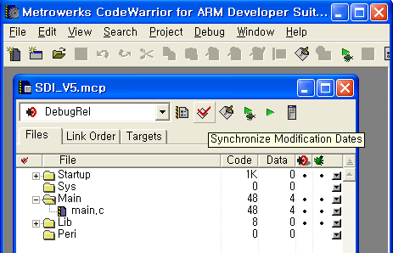
HowToUsing ADS

Slide 4
